Slide 1




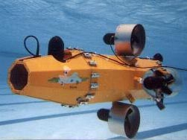



Background – Pre-AF

Slide 2
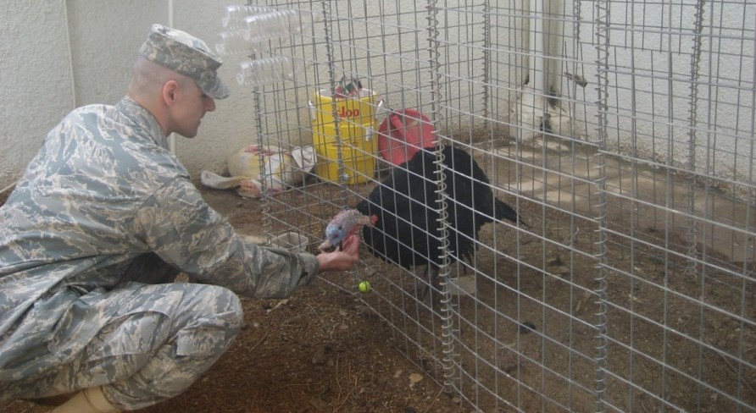
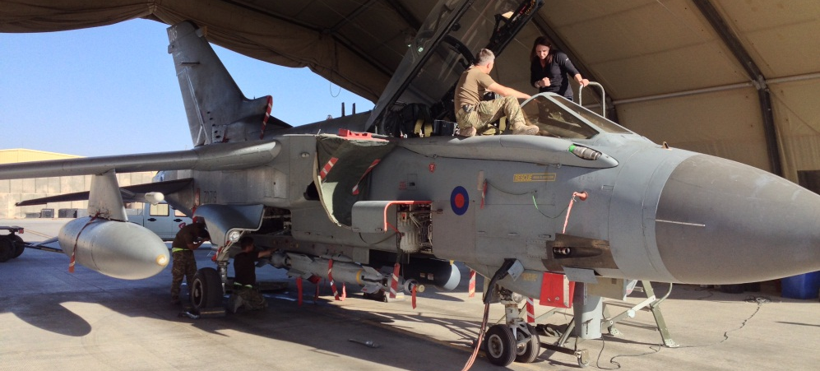
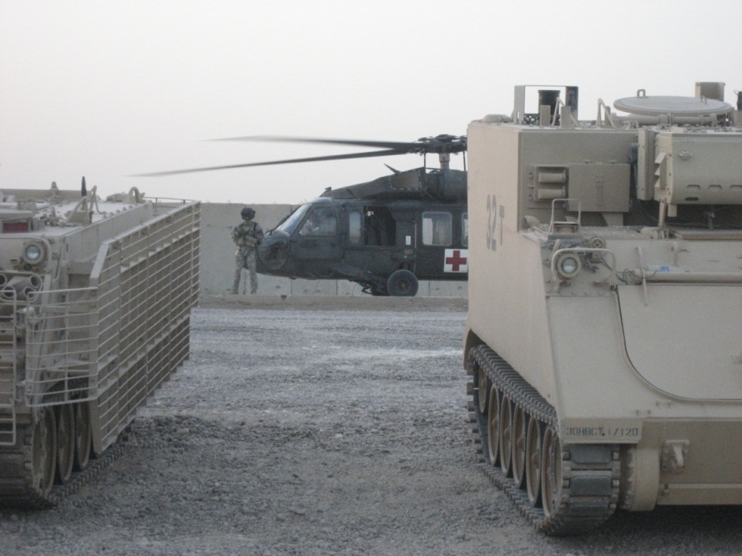
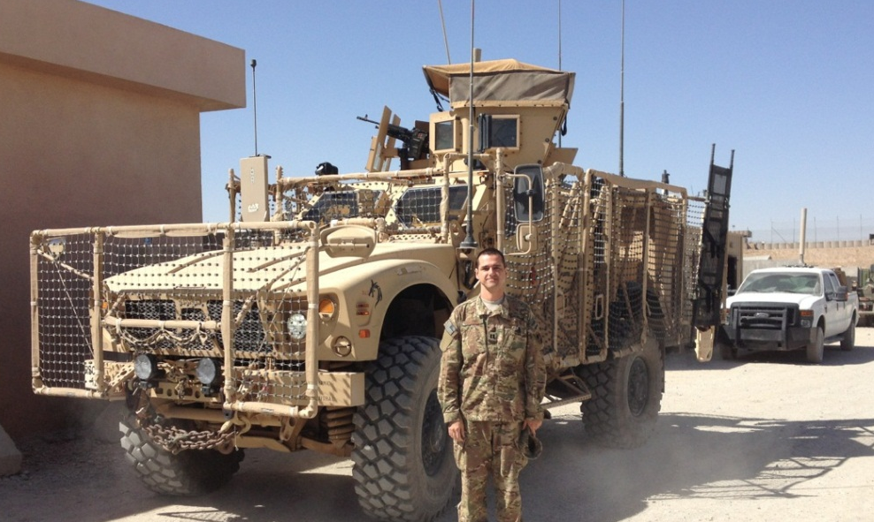



Background - Deployments
Iraq Feb – Aug 09
Afghanistan Sept 13 – Feb 14
DCMA Southern Iraq: LOGCAP
ISAF CJ2: NRO LNO

Slide 3
Expectations
Read and be familiar with course materials (e.g., syllabus, course letter, etc)
Read the day’s section before the class
No surfing the internet/texting/etc during class
Be on time
No backpacks on tables
Be professional
Ask questions during class and stay engaged
Remember: This class is for you to learn, not for me to teach

Slide 4
Math 152 – Lesson 1
Lesson | Topic | Reading | Homework
1 | Areas & Distances | 5.1 | 2,13
2 | The Definite Integral | 5.2 | 5,8
3 | Approximate Integration | 7.7 | 2,11
Objectives:
Explain how to interpret area between the curve and the axis as the limit of a sum of areas of thin rectangles
Use sigma notation to express Riemann sums (left, right, general) and be able to calculate it
Determine upper and lower Riemann sums to bound area estimates
Estimate distance travelled given velocity and time data

Slide 5
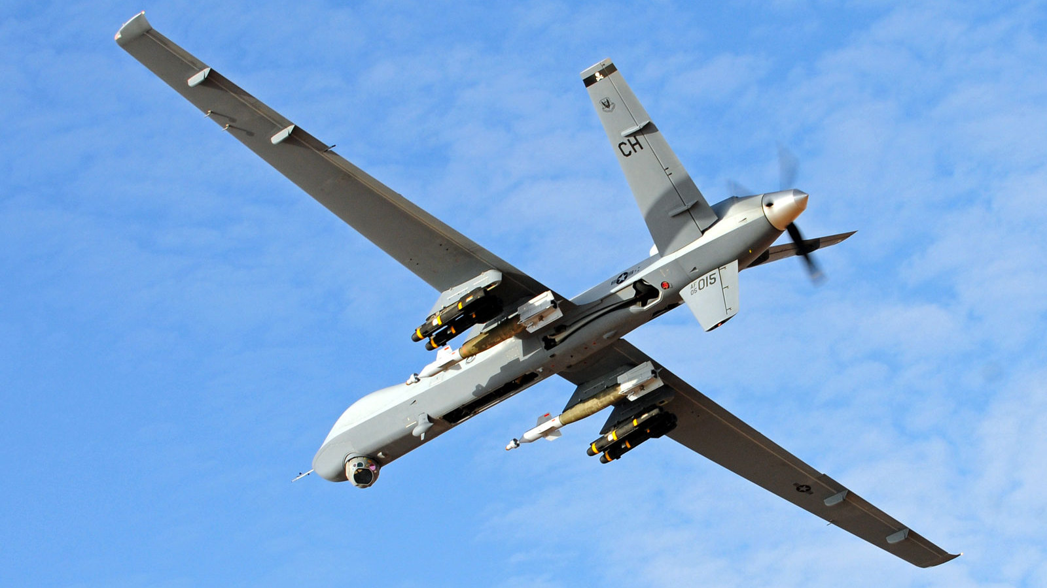
Why Do We Care?
Paveway II

Slide 6
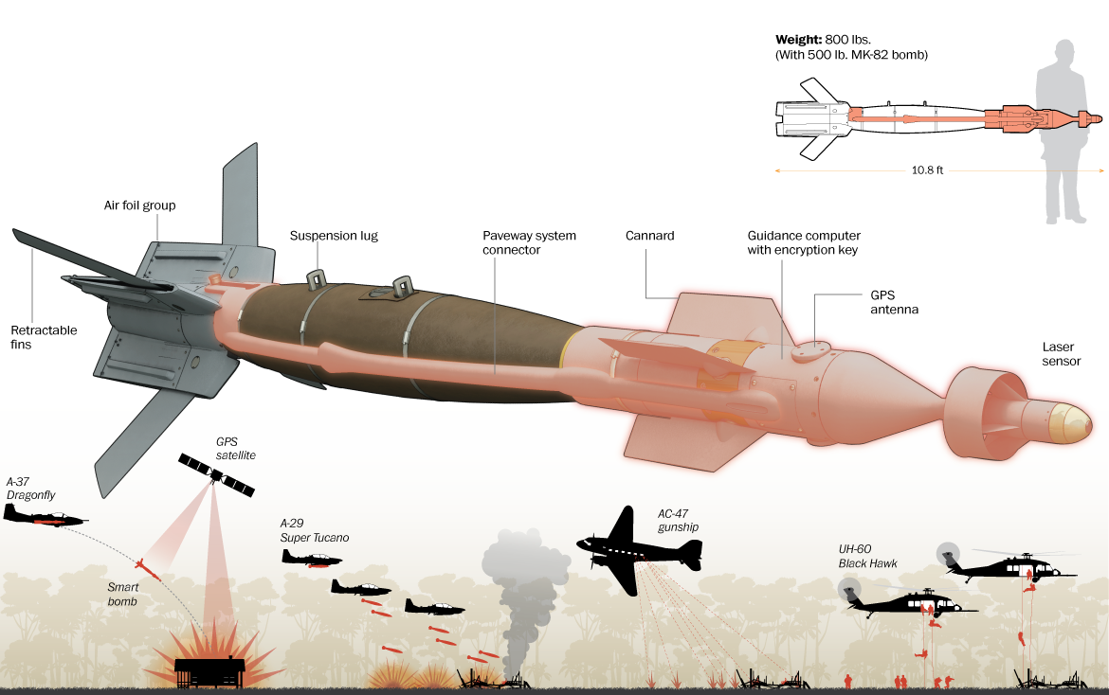
Precision Guided Munitions
Paveway II
Inertial sensors: acceleration & rotation rates with high speed updates
GPS is slow to update

Slide 7
Area Problem
Goal: Find area under the curve
How do we do this?

Slide 8
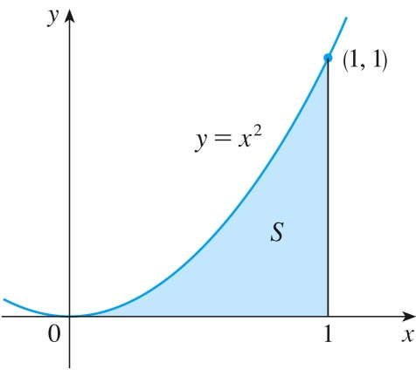
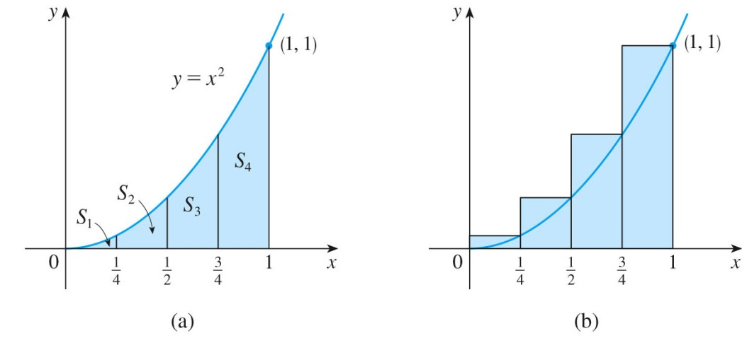
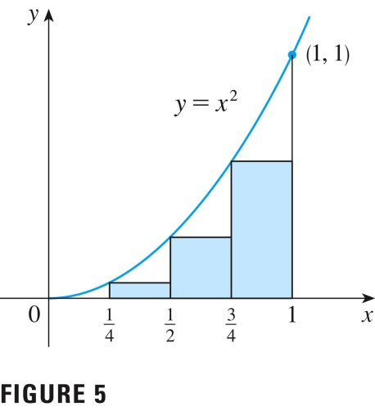


Area Under a Curve
Use rectangles to estimate the area under the parabola y = x² from 0 to 1.
We see that the area of S is larger than LHS₄, so we have lower and upper estimates for S: 0.21875 < S < 0.46875
RHS
LHS
${RHS}_{4}= \frac{1}{4}{\left(\frac{1}{4}\right)}^{2}$+$\frac{1}{4}{\left(\frac{1}{2}\right)}^{2}\text{+} \frac{1}{4}{\left(\frac{3}{4}\right)}^{2}$+$\frac{1}{4}{\left(1\right)}^{2}=\frac{15}{32}=0.46875$
${LHS}_{4}=\frac{1}{4}{\left(0\right)}^{2}+\frac{1}{4}{\left(\frac{1}{4}\right)}^{2}$+$\frac{1}{4}{\left(\frac{1}{2}\right)}^{2}\text{+} \frac{1}{4}{\left(\frac{3}{4}\right)}^{2}=\frac{7}{32}=0.21875$
Notes:
Solid example with a function

Slide 9
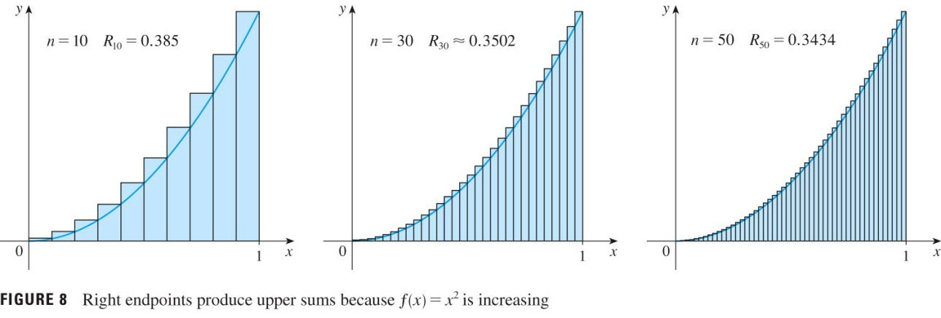
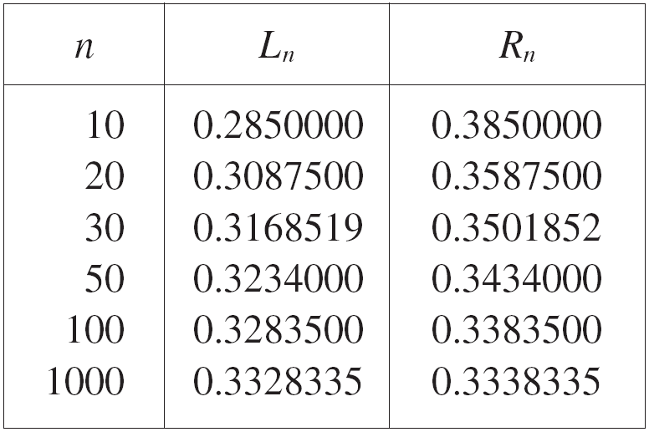
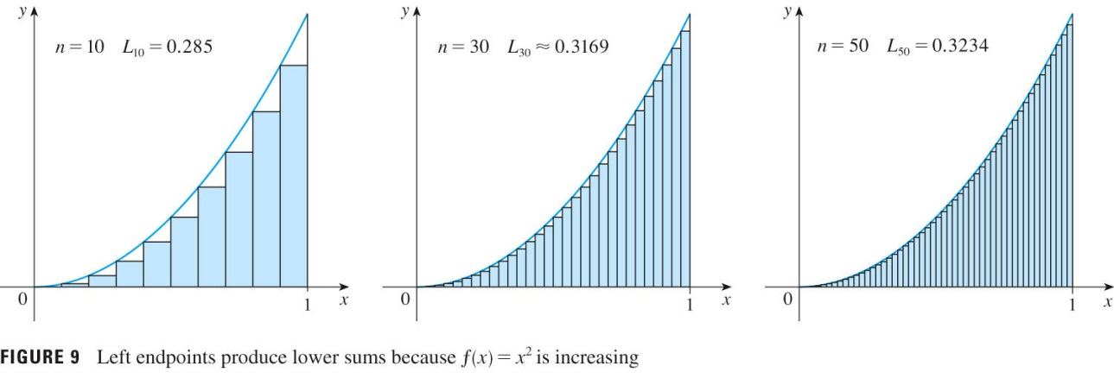
Increase Accuracy of Estimate
We could obtain better estimates by increasing the number of strips.
R_{n} = f (x₁) Δx + f (x₂) Δx + … + f (x_{n}) Δx
Right Hand Side
Left Hand Side
S
Notes:
Which is under and over estimate
Why?

Slide 10
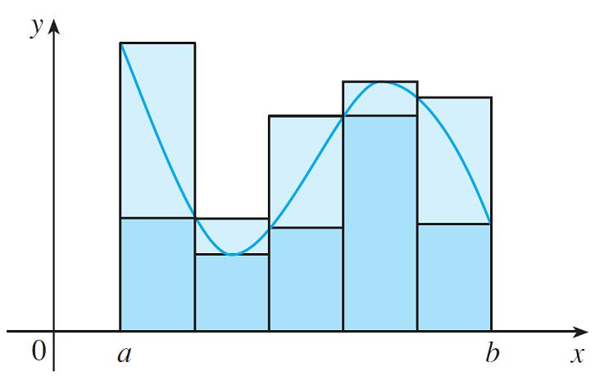
The Area Problems
In general, we form lower (and upper) sums by choosing the sample points so that is the minimum (and maximum) value of f on the i th subinterval.
Max Pt in interval
Min Pt in interval
interval
Lower sums (short rectangles) and upper sums (tall rectangles)
Note: RHS and LHS can calculate either lower or upper sum depending on shape of curve

Slide 11
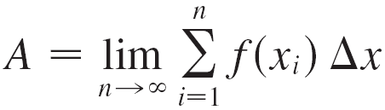
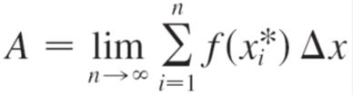
Notation
Reimann Sum
S
RHS
S
LHS
S
Sample Point

Slide 12
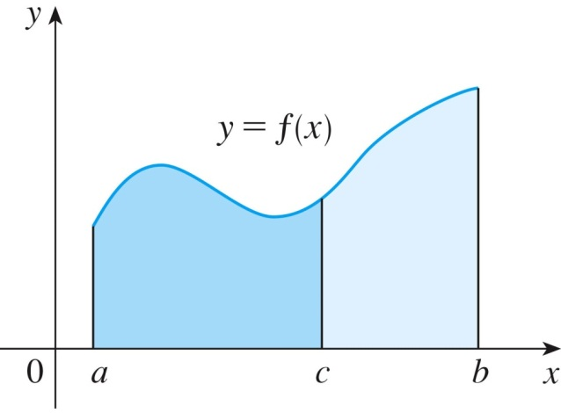
Where Am I?
Sensor Data
Area under Accel curve provides Velocity
Acceleration (m/sec^2)
Vel (m/sec) = Accel (m/sec^2) * Time (sec)
Time (sec)
Area under Velocity curve provides Position
Velocity (m/sec)
Position (m) = Vel (m/sec) * Time (sec)
Time (sec)
Munitions use these principles to kill our enemies

Slide 13
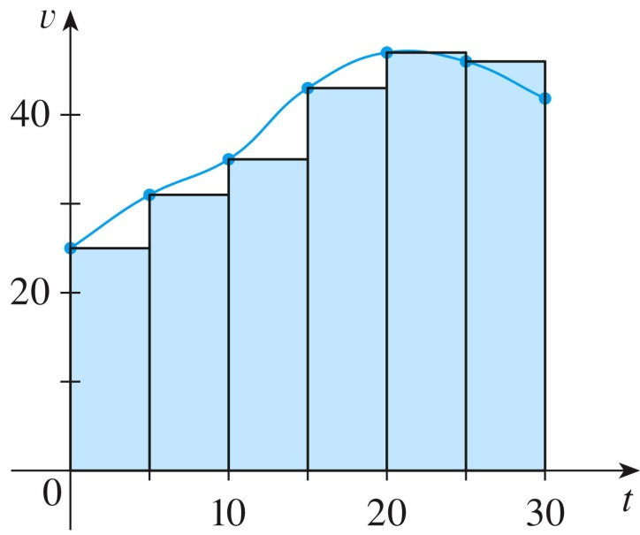

Simple Distance Work
Given the velocity of an object taken every 5 seconds, calculate the object’s position using LHS and RHS strips:
Left endpoints:
Right endpoints:
Time (s) | 0 | 5 | 10 | 15 | 20 | 25 | 30
Velocity (ft/s) | 25 | 31 | 35 | 43 | 47 | 46 | 41
$$∆t=\frac{b−a}{n}$$
Total distance traveled between t=a and t=b
$≈f\left(t_{0}\right)∆t+$ $f\left(t_{1}\right)∆t+$ $f\left(t_{2}\right)∆t+⋯+f\left(t_{n−1}\right)∆t$
${LHS}_{6}=5\left(25\right)$ + $5\left(31\right)$ + $5\left(35\right)$ +$5\left(43\right)\text{ +} 5\left(47\right)\text{ +} 5\left(46\right)=1135 ft$
${RHS}_{6}=$ $5\left(31\right)$ +$5\left(35\right)$ + $5\left(43\right)\text{ +} 5\left(47\right)\text{ +} 5\left(46\right)\text{ +} 5\left(41\right)=1215 ft$
Notes:
Start with MPH general question
Graph Table Points
Draw rectangles
Have Cadets draw RHS or General on picture
Intro Sigma Notation

Slide 14



Next Class: Definite Integrals
The estimations we’ve seen are called Riemann Sums and take the form:
$$\sum_{i=1}^{n}{f({x∗}_{i}^{})∆x}$$
Regardless of which type of Riemann sum we use, we’ll get better estimate as we let the number of subintervals get larger.
How do we find the exact area under the curve?
$$\lim_{n→∞}{\sum_{i=1}^{n}{f(x{}_{i}^{∗} )∆x}}$$
=$\int_{a}^{b}{f\left(x\right)dx}$
Notes:
Answer is 0.691908
Emphasize that you CAN’T interpolate if data is tabular

Slide 15
Backups

Slide 16
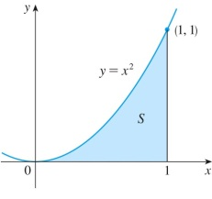
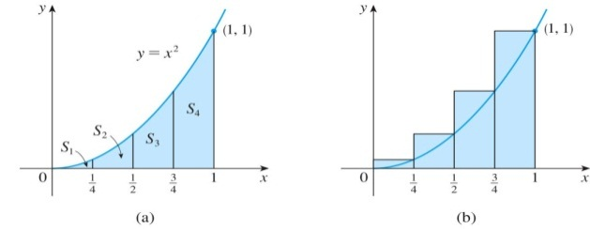


Summary of Objectives
Objectives:
Explain how to interpret area between the curve and the axis as the limit of a sum of areas of thin rectangles
Use sigma notation to express Riemann sums (left, right, general) and be able to calculate it
Determine upper and lower Riemann sums to bound area estimates
Estimate distance travelled given velocity and time data
Position (m) = Vel (m/sec) * Time (sec)

Slide 17
Concerns on Accuracy
Selecting inappropriate rectangle sizes effects accuracy of area estimate
If the function below represents accelerometer readings on munitions, notice that this approximation become better as the number of rectangles increases, that is, as n → ∞
Poor
Good
Estimate of velocity and position for munitions

Slide 18
Riemann Sums
The estimations we’ve seen are called Riemann Sums and take the form:
$$\sum_{i=1}^{n}{f({x∗}_{i}^{})∆x}$$
Regardless of which type of Riemann sum we use, we’ll get better estimate as we let the number of subintervals get larger.
How do we find the exact area under the curve?
$$\lim_{n→∞}{\sum_{i=1}^{n}{f(x{}_{i}^{∗} )∆x}}$$
=$\int_{a}^{b}{f\left(x\right)dx}$
Notes:
Answer is 0.691908
Emphasize that you CAN’T interpolate if data is tabular

Slide 19
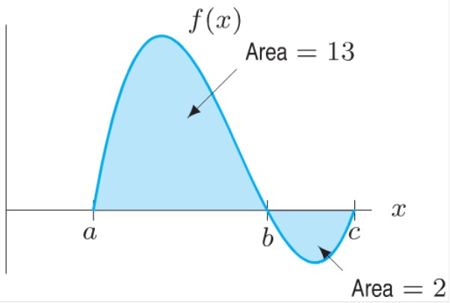
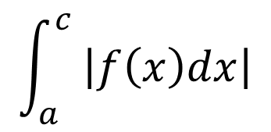


Definite Integral
A definite integral can be interpreted as a net area or the difference of areas
Calculate the following definite integrals:
$$\int_{a}^{b}{f\left(x\right)dx}$$
$$\int_{a}^{c}{f\left(x\right)dx}$$
$$\int_{b}^{c}{f\left(x\right)dx}$$
$$\int_{a}^{c}{ \left|f\left(x\right)dx\right|}$$
Notes:
Try these cold before next slide

Slide 20
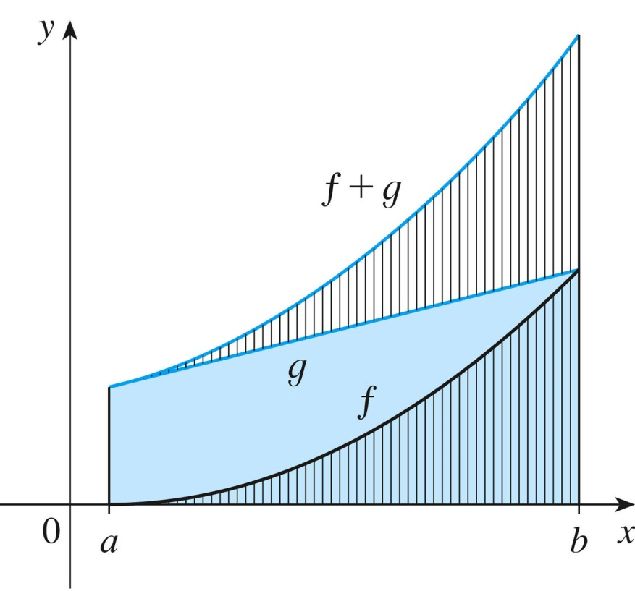

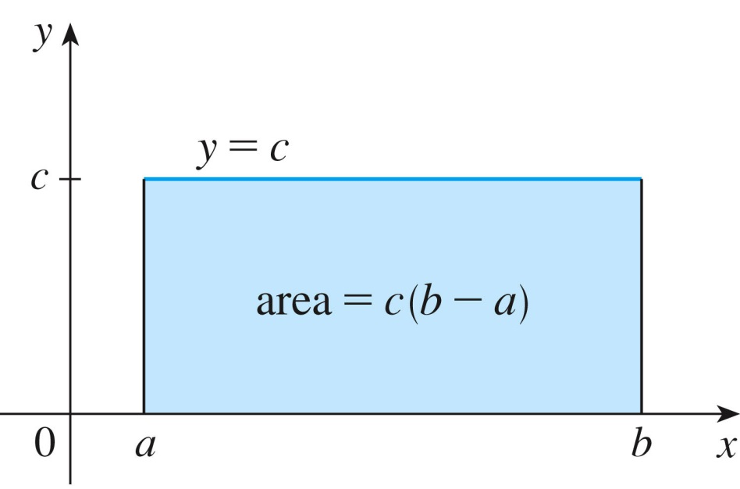
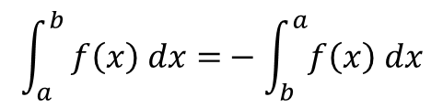
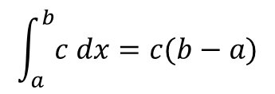
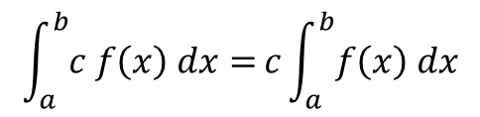

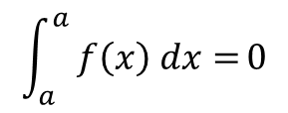
Integral Properties
$$\int_{a}^{b}{[f\left(x\right)∓g\left(x\right) ]dx=}\int_{a}^{b}{f\left(x\right) dx}∓\int_{a}^{b}{g\left(x\right) dx}$$
$$\int_{a}^{b}{c f\left(x\right) dx=}c\int_{a}^{b}{f\left(x\right) dx}$$
$$\int_{a}^{b}{c dx=c(b−a)}$$
$$\int_{a}^{b}{ f\left(x\right) dx=}−\int_{b}^{a}{f\left(x\right) dx}$$
$$\int_{a}^{a}{ f\left(x\right) dx=}0$$
$$\int_{a}^{c}{f\left(x\right) dx}+\int_{c}^{b}{f\left(x\right) dx}=\int_{a}^{b}{f\left(x\right) dx}$$

